Slide 1

A* implementation
Andrew Massey

Slide 2

Regret
This project was not what I had hoped it would be. I thought that the concept of implementing A* would be a nice fun easy thing to do. I was wrong.

Slide 3
The Goal

Slide 4

What is Pygame
Pygame is a library made for python that is designed to assist people learning python while also making it fun because you are making a game.
I found it incredibly intuitive to use however did run into a few issues before I learned how much their website helped.

Slide 5
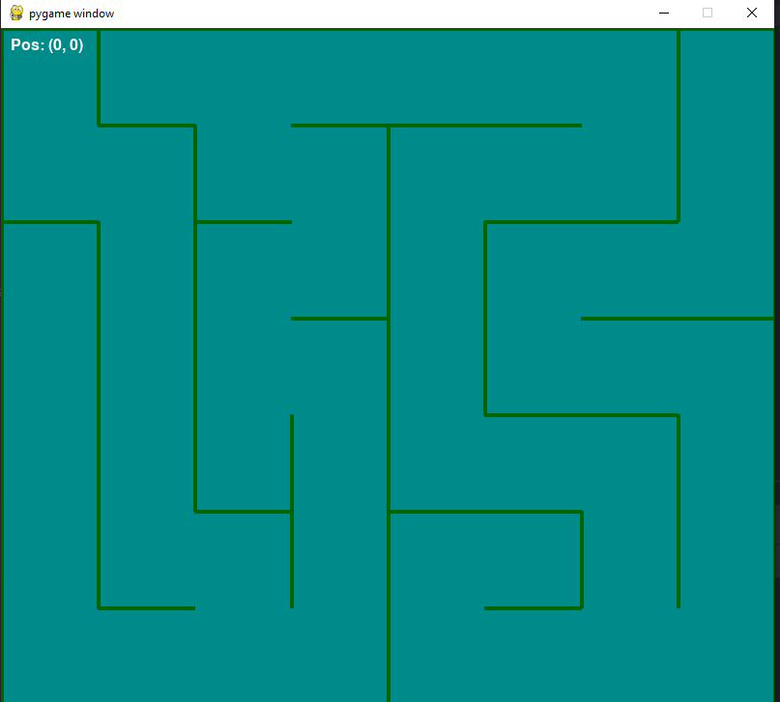
The Maze
This is an example of the maze generated using pygame.
It is generated by starting at the top left corner and moving through the maze picking random spots to put down walls
The size of the maze can be adjusted to nearly any size.

Slide 6
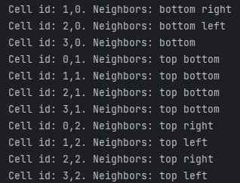

How we can see the walls
This is done by assigning each cell a base of zero open neighbors.
Then, once the maze has fully generated it adds all of the sides of the cell that do not have a wall to a list called neighbors.
From there it is as simple as checking the cell that we are currently in for its neighbors and only allowing it to move there.
For example:

Slide 7
Manual Maze Navigation
The first step to implementing A* was to make it so that I myself could solve the maze.
This is fairly straight forward using:
if pressed_keys[pygame.K_UP] and c_cell.neighbors['top']:

Slide 8
Start and End Points

Slide 9
Heuristics

Slide 10
Desperation
Talk about random movement

Slide 11
What could have been

Slide 12
Acknowledgements

Slide 13
References

